Slide 1
Forest Fires:
A Predictive Analysis
By: Nadav Levanoni and Johnathan Ly

Slide 2
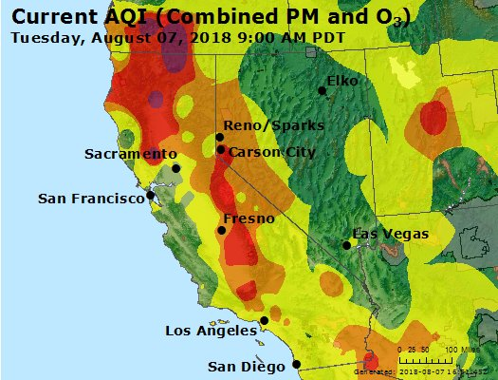
Our Mission: Save Lives
In 2018 alone 97 civilians and 6 firefighters died from forest fires in California.
We will provide a predictive analysis to that will supply civilians and firefighters with foresight of the expected severity (size) of the fire will last so they can act accordingly.

Slide 3
Cleaning the Data
Data Sources: Kaggle
Fires = SQLite Database with information on 1.88 million U.S. fires from 1992-2015
Ca Weather: Monthly Temperatures for each County since 1895
Weather = Dataset with multiple csv files containing insightful Hourly Weather Conditions for 30 Major Cities from 2012-2017
Cleaning
Dropped irrelevant columns and rows with missing values (except for County: used ffill after sorting by coordinates)
Merged Fires and Ca Weather data on Month and County
Reduced and Categorized Counties in the Fire Dataframe to match the provided California cities in the Weather Data Frame
Converted Hourly Weather Data to Daily Weather Data
Converted messy Time Data for both Data Frames into datetime Data Type
Converted weather conditions to boolean Rain/ No Rain
Merged Dataframes on City and Date
Result
Data Frame containing weather conditions and fire information
Dates span from 2012 through 2015
Geographical data limited to the Greater Los Angeles, San Diego, and San Francisco area

Slide 4
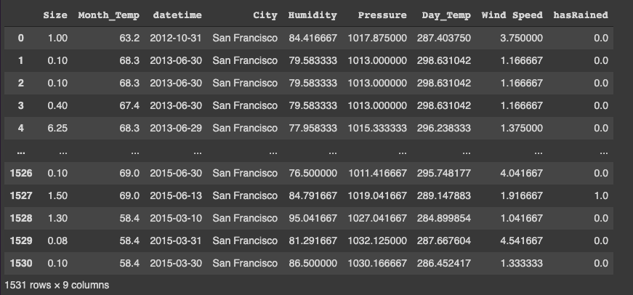
Finalized Data

Slide 5
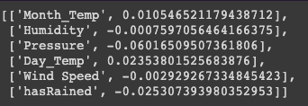
Feature Extraction
Choosing Features
Calculated the correlations between each numerical attribute of the data with the Size column
The correlation coefficients were all very small in magnitude, so we included all of the attributes as inputs for our models
Multiplied columns with negative correlations by -1
Normalized the inputs except for hasRained (which was converted to 0s and 1s for boolean)
Very
Unexpected

Slide 6
Machine Learning: Regression
1st Model: Predicting Size
Inputs:
Month_Temp: The average temperature during the month that the fire occurred
Humidity: Average humidity throughout the day of that the fire broke out
Day_Temp: The average temperature of the day the fire broke out
Pressure: Indicative of the dew point (ex. Precipitation on grass)
Wind Speed: Average wind speed throughout the day that the fire broke out
hasRained: Whether or not it had rained that day
Output
SIze: Predicted Acres of land burned by the fire
Accuracy:
Average difference in predicted and actual Size of fire for the testing set: 13.4 acres

Slide 7
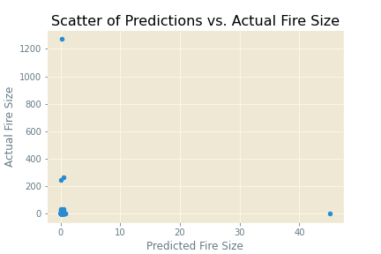
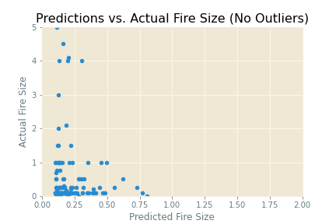
Visualizing the Accuracy of the Model
What it means to overpredict vs underpredict in context.
very bad
Better safe than sorry

Slide 8
Machine Learning: Neural Network
The Model
Inputs:
Month_Temp: The average temperature during the month that the fire occurred
Humidity: Average humidity throughout the day of that the fire broke out
Day_Temp: The average temperature of the day the fire broke out
Pressure: Indicative of the dew point (ex. Precipitation on grass)
Wind Speed: Average wind speed throughout the day that the fire broke out
hasRained: Whether or not it had rained that day
Building the NN:
Set loss function to be “mean_squared_logarithmic_error”
Accuracy:
Regardless of how we attempted to build the NN, the accuracy was consistently around 0.11

Slide 9
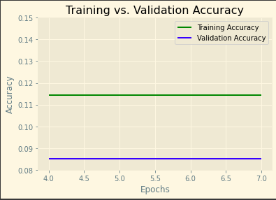
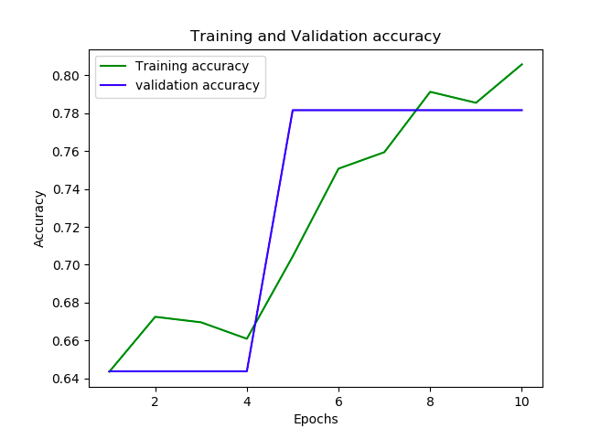
Visualizing the Accuracy of the Model
Our model: Ideal model:

Slide 10
Reflection
Regression
Neural Network
Visual Data and Results were hard to process at times
Hard to observe where our model becomes inaccurate and why
Not very accurate at predicting fire severity
Has an accuracy of ~11%
Meaningful Visual Insight on our results
Easy to see flaws and trends in our data
Relatively accurate at predicting smaller fires
Was off by an Average of 13.4 acres

Slide 11
Shortcomings & Takeaways
Problems Encountered:
Data Gathering/Cleaning:
Attempted to scrape data from Weather Underground API, however, it is not free to do so.
Ideally we would have more rows/ entries
It’s harder than we thought to find strong correlations in data
Just because something is commonly assumed to be true, it doesn’t mean you will be able to correctly identify said trends in your model
Machine Learning Models:
Accuracy was nowhere near as high as we would have liked
Neural Network model behaved oddly
Takeaways:
In certain contexts, under-predicting may be more harmful than over-predicting and vice versa
Amount of Data, Data Accuracy, and effectiveness of Data Cleaning can make or break any model

Slide 12
Questions

